Slide 1
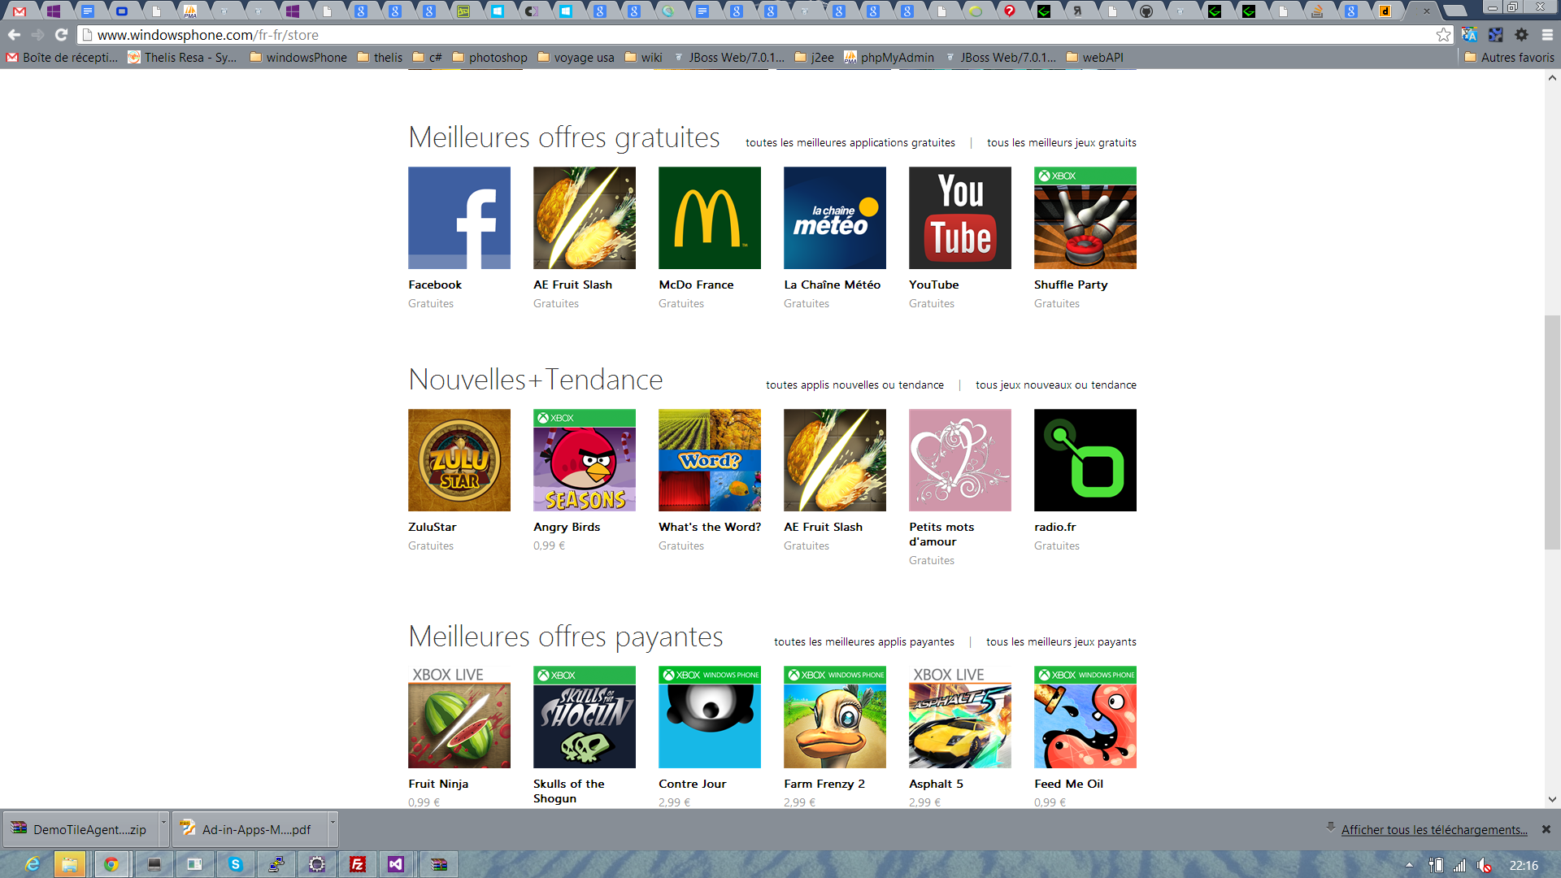

Slide 2










AppRoulette

Slide 3
AppRoulette

Slide 4

